Slide 1


CMR TECHNICAL CAMPUS
UGC AUTONOMOUS
Accredited by NBA & NAAC with A Grade
Approved by AICTE, New Delhi and Affiliated to JNTU, Hyderabad
Department of Information Technology
Major Project stage -2
Review-2
Project Title : Neural Network-Based Predictive Modeling for Complex Psychiatric Disorder Identification using EEG Features
Project Supervisor :
Name : V. SRI SUMA
Designation: Assistant Professor
Presented By:
Batch No : 11
1. H. No: 227R1A1292 Name: G. Tejaswini
2. H. No: 227R1A12B1 Name: M. Rithesh Pavan
3. H. No: 227R1A1267 Name: A. Hari Vardhan

Slide 2
CONTENTS
Introduction and overview
Existing system
Existing System-Disadvantages
Proposed system
Proposed System-Advantages
Software and Hardware Requirements
Novelty of the project
System Architecture
Modules
Source Code
Results
UML Diagrams
Conclusion & Enhancement
References
GitHub Link

Slide 3
INTRODUCTION AND OVERVIEW
Mental and neurological disorders affect over 450 million people worldwide, yet their diagnosis often depends on subjective clinical assessments, leading to inaccurate or delayed treatment. To address this challenge, this project proposes a web-based Flask application for automated EEG-based disorder classification using machine learning and deep learning techniques. The system incorporates secure role-based access, enabling administrators to train and compare multiple classifiers—including Random Forest, Support Vector Machine (SVM), Logistic Regression, Decision Tree, and Hybrid Graph Neural Networks—while users can upload EEG data for real-time predictions. Using EEG datasets sourced from Kaggle, the application classifies six major psychiatric disorder categories such as anxiety, mood, and trauma-related conditions by identifying complex brain signal patterns. This automated, AI-driven approach improves diagnostic accuracy, reduces manual effort, enhances clinical efficiency, and supports research in precision psychiatry and neurological disorder analysis.

Slide 4
EXISTING SYSTEM
Traditional EEG-based diagnosis relied on manual waveform analysis, clinical observations, and basic machine learning methods such as KNN and Naive Bayes. These approaches required manual feature extraction, were time-consuming, and failed to capture complex EEG patterns, leading to limited accuracy and inconsistent results. The lack of automation and real-time analysis made traditional systems inefficient, highlighting the need for advanced, data-driven diagnostic methods.

Slide 5
DISADVANTAGES OF EXISTING SYSTEM
Diagnosis and feature selection rely heavily on expert knowledge, leading to subjective and inconsistent results.
Manual EEG signal analysis and feature extraction are time-consuming and unsuitable for real-time diagnosis.
Traditional methods fail to capture complex, nonlinear patterns present in EEG signals, reducing classification accuracy.
Classical models such as KNN, Naïve Bayes, and LDA show poor performance and generalization on large, noisy EEG datasets.

Slide 6
PROPOSED SYSTEM
This project introduces a Flask-based web application that integrates secure user management and advanced machine learning (ML) algorithms including Random Forests, Support Vector Machines, Logistic Regression, Decision Trees, and a Hybrid Graph Neural Network to automate the classification of main and specific EEG-based disorders. The system allows for role-based access, model training, feature exploration, performance comparison, and user-side batch predictions via web interface, leveraging a broad spectrum of EEG-derived features and demographic information.

Slide 7
PROPOSED SYSTEM ADVANTAGES
Automation: Reduces manual EEG interpretation and human error.
Accuracy: Uses multiple ML models for precise disorder classification.
Efficiency: Enables faster analysis and decision-making.
Early Detection: Facilitates timely diagnosis of neuropsychiatric disorders.

Slide 8
SOFTWARE AND HARDWARE REQUIREMENTS
SOFTWARE REQUIREMENTS
Python 3.12.0
Operating system: Windows
Frontend: HTML, CSS
Backend: Flask Server
Database: SQLite
HARDWARE REQUIREMENTS
Processor: Intel i5
Memory: 1 TB (storage)
RAM: 8 GB

Slide 9
NOVELTY OF THE PROJECT
This project presents a novel EEG-based psychiatric disorder identification system that classifies multiple mental health disorders using machine learning. Unlike traditional methods, it compares several ML models including Random Forest, SVM, Logistic Regression, Decision Tree, and a Hybrid Graph Neural Network. The system captures complex EEG feature relationships for improved accuracy. A secure Flask-based web application enables real-time predictions through CSV uploads. Role-based access separates model training and user prediction functions. Overall, the project offers a scalable, automated, and clinically useful solution for mental health diagnosis.

Slide 10
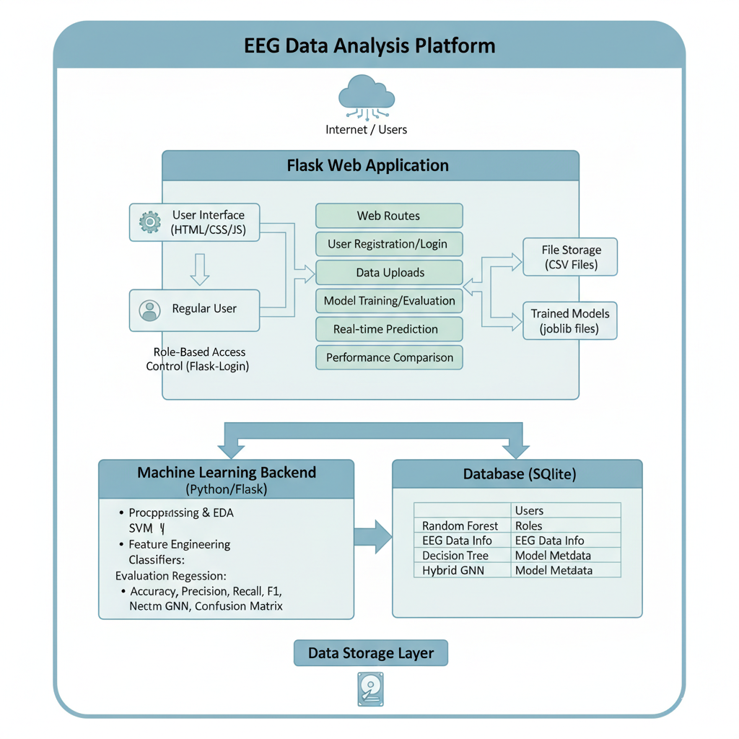
SYSTEM ARCHITECTURE

Slide 11
MODULES
1.User Management Module:
Handles user registration, login, logout, and role-based authentication using Flask-Login.
Manages user data within an SQLite database.
Differentiates between admin and regular users for access control.
2.Data Management Module
Manages uploading EEG CSV files securely.
Loads and preprocesses EEG data for training and prediction, including handling missing values and feature selection.

Slide 12
3.Machine Learning Module
Implements multiple classifiers: Random Forest, SVM, Logistic Regression, Decision Tree, and Hybrid Graph Neural Network.
Includes functions for training, model saving/loading, prediction, and evaluation metrics calculation.
Supports both main and specific disorder classification tasks.
4.Exploratory Data Analysis (EDA) Module
Provides statistical summaries and feature insights of the EEG dataset.
Renders EDA results accessible primarily to admin users..
5.Prediction Module
Allows regular users to upload EEG data CSVs and get classification predictions.
Integrates with pre-trained models and provides user-friendly prediction results.

Slide 13
6.Performance Comparison Module:
Compares classifier performance across disorders.
Displays accuracy, precision, recall, F1 score, confusion matrices, and classification reports for each model.
7.Web Interface Module:
Implements Flask routes and associated HTML templates for interaction.
Provides pages for registration, login, home, EDA, classification selection, prediction, and results display.
Uses flash messages for user feedback.

Slide 14
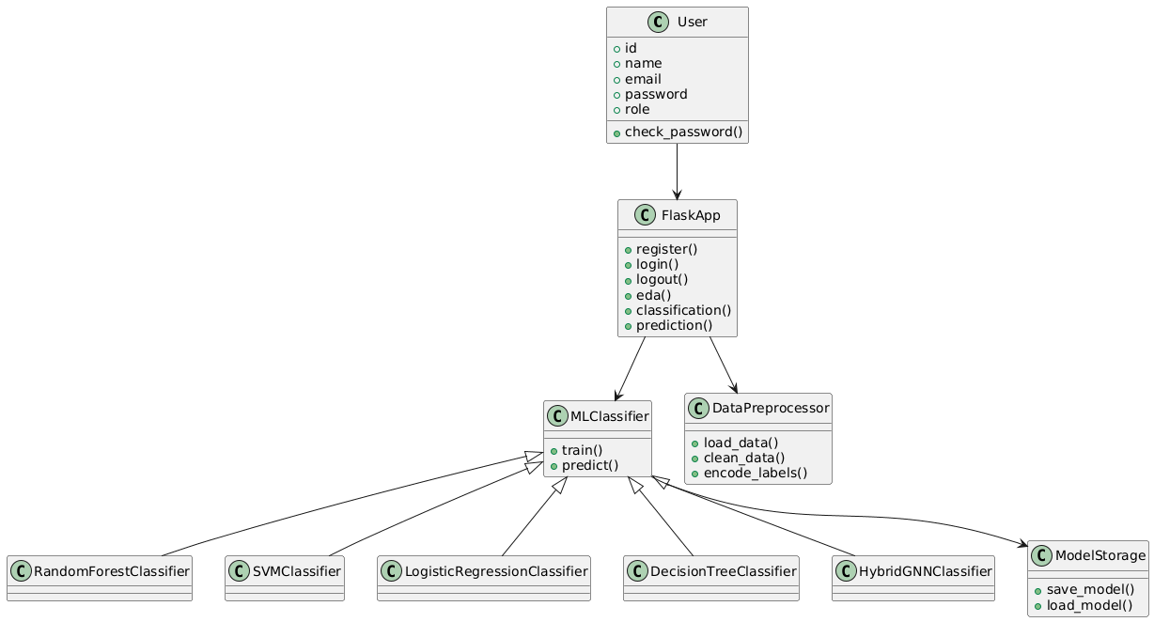
UML DIAGRAMS
CLASS DIAGRAM:

Slide 15
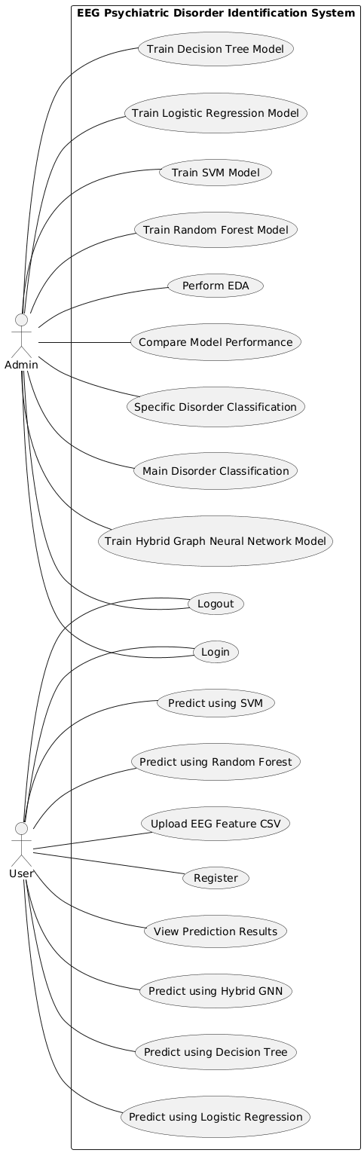
UML DIAGRAMS
USE CASE DIAGRAM:

Slide 16
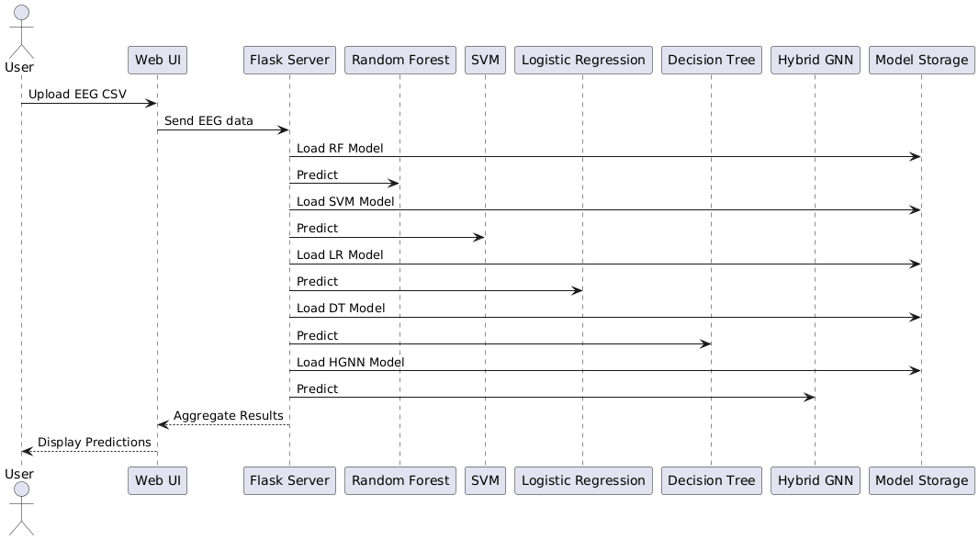
UML DIAGRAMS
SEQUENCE DIAGRAM:

Slide 17
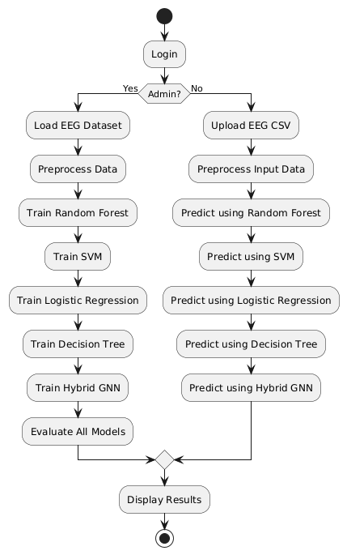
UML DIAGRAMS
ACTIVITY DIAGRAM:

Slide 18
SOURCE CODE
1. Login Authentication
user = User.get_by_email(email)
if user and user.check_password(password):
login_user(user)
flash('Login successful!', 'success')
return redirect(url_for('home'))
else:
flash('Invalid email or password!', 'danger')

Slide 19
SOURCE CODE
2. Admin Access Control
def admin_required(f):
@wraps(f)
def decorated_function(*args, **kwargs):
if not current_user.is_authenticated or current_user.role != 'admin':
flash('You need admin privileges to access this page.', 'danger')
return redirect(url_for('home'))
return f(*args, **kwargs)
return decorated_function

Slide 20
SOURCE CODE
3. Model Training Logic
selected_classifiers = request.form.getlist('classifiers')
if not selected_classifiers:
flash('Please select at least one classifier!', 'warning’)
return redirect(url_for('main_disorder_classification’))
results = train_all_classifiers('main.disorder')
filtered_results = {k: v for k, v in results.items() if k in selected_classifiers}

Slide 21
SOURCE CODE
4. File upload + prediction
if file and file.filename.endswith('.csv’):
filename = secure_filename(file.filename)
filepath = os.path.join(app.config['UPLOAD_FOLDER'], filename)
file.save(filepath)
predictions = predict_from_csv(filepath, target_column)
df_original = pd.read_csv(filepath)

Slide 22
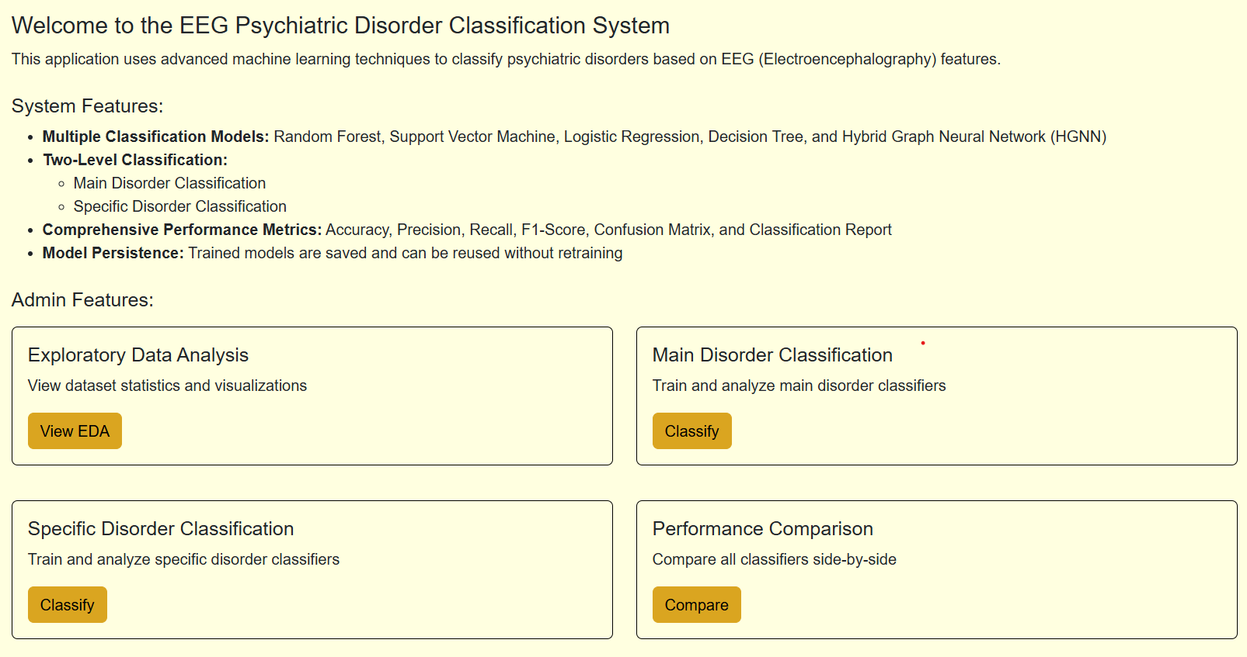
RESULTS
Home page after admin login
Admin dashboard serves as the central hub of the EEG Psychiatric Disorder Classification System.
It highlights key features like multi-model classification, two-level prediction, and performance metrics.
Provides quick access to data analysis, model training, evaluation, and comparison in one interface.

Slide 23
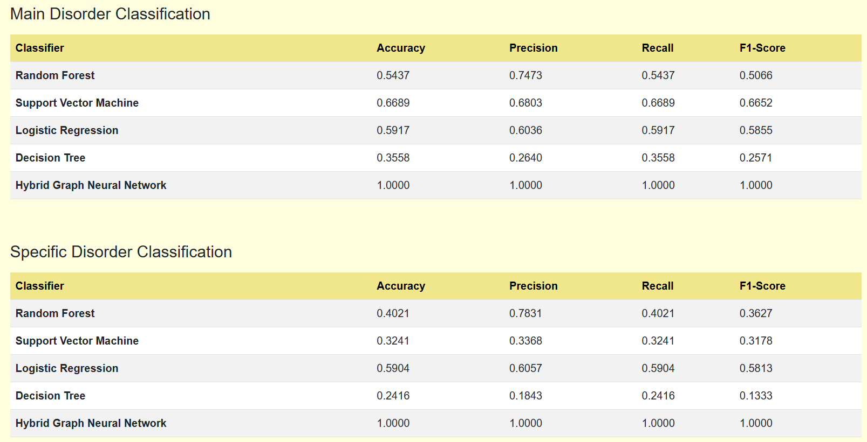
RESULTS
Performance of classifiers for main disorder and specific disorder
Performance comparison page evaluates all models using Accuracy, Precision, Recall, and F1-Score.
SVM and Logistic Regression show consistent performance, while Random Forest and Decision Tree perform lower.
HGNN achieves perfect results, proving superior for accurate psychiatric disorder classification.

Slide 24
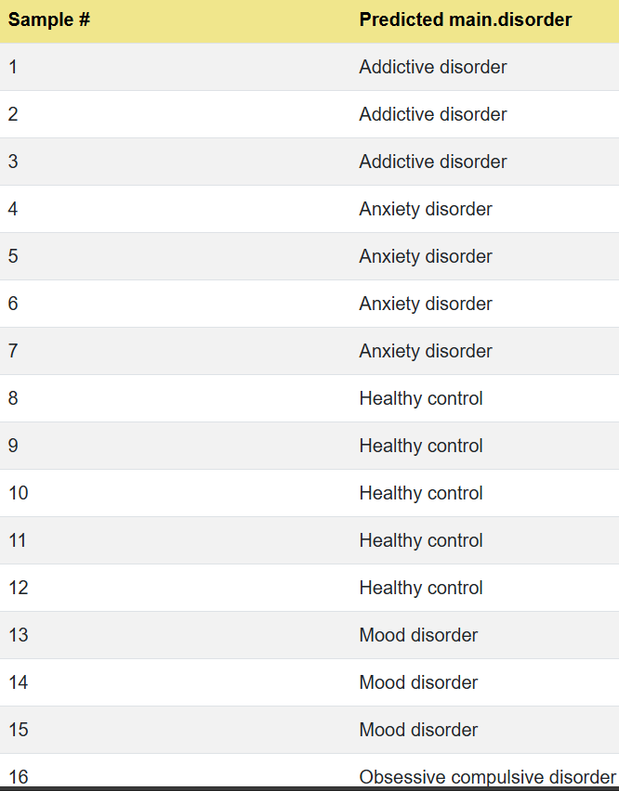
RESULTS
Prediction obtained using HGNN on main disorder
HGNN model accurately classifies EEG samples into main psychiatric disorder categories.
Predictions show clear differentiation between disorders like anxiety, mood, OCD, and healthy control.
Consistent results highlight the model’s effectiveness for reliable main-level disorder identification.

Slide 25
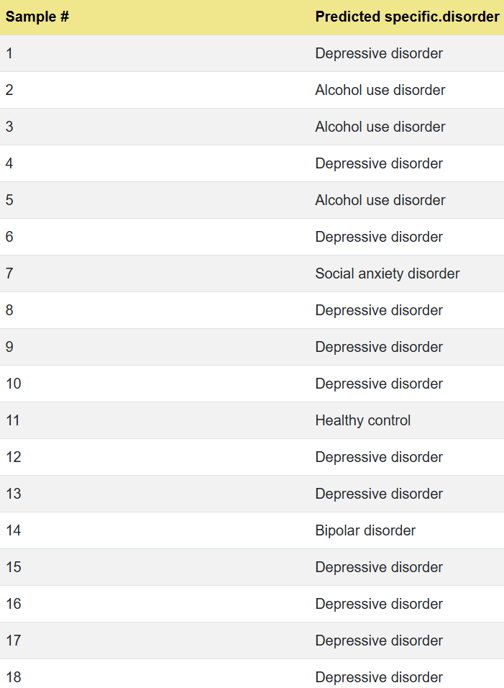
RESULTS
The figure shows specific disorder prediction results obtained using the proposed Hybrid Graph Neural Network (HGNN) demonstrate the model’s capability to perform fine-grained psychiatric disorder classification from EEG features. Each EEG sample is classified into a precise disorder category such as depressive disorder, alcohol use disorder, social anxiety disorder, bipolar disorder, or healthy control. The consistent and coherent predictions across multiple samples indicate that the HGNN effectively captures subtle EEG signal variations associated with different psychiatric conditions. This output validates the effectiveness of the proposed model for detailed, specific-level psychiatric disorder identification.

Slide 26
CONCLUSION AND FUTURE ASPECTS
CONCLUSION
The system enables automated psychiatric disorder detection using EEG data with multiple ML models and preprocessing techniques.
The proposed HGNN model achieves the highest accuracy, making the system reliable and effective for early diagnosis.
FUTURE ASPECTS
Future work includes real-time EEG monitoring and integration of advanced models like CNNs, LSTMs, and Transformers.
The system can be expanded with personalization, cloud deployment, and mobile support for scalable remote diagnosis.

Slide 27
REFERENCES
[1].Li, S.; Zhou, W.; Yuan, Q.; Geng, S.; Cai, D. Feature extraction and recognition of ictal EEG using EMD and SVM. Comput. Biol.Med. 2013,43, 807–816.
[2].Satapathy, S.K.; Jagadev, A.K.; Dehuri, S. Wei ghted majority voting based ensemble of classiﬁers using different machine learning techniques for classiﬁcation of EEG signal to detect epileptic seizure. Informatica 2017,41.
[3].Manali, M.; Satija, U.; Upadhayay, M.D. Variational Mode Decomposition Based Mental Task Classification from Electroencephalogram. In Proceedings of the 2020 IEEE 17th India Council International Conference (INDICON), New Delhi, India, 10–13 December 2020; pp. 1–7.

Slide 28
GITHUB LINK
https://github.com/gundaganitejaswini05/Neural-Network-Based-Predictive-Modeling-for-Complex-Psychiatric-Disorders

Slide 29
THANKYOU

